Slide 1

INTRODUCTION TO C++

Slide 2

PLAN FOR TODAY
  How computers think?
  Why programming languages exist?
  Writing our first C++ code
  Rules of printing
  Data types & operators
  Taking input
  Making decisions (if-else)
  Assignments walkthrough

Slide 3

What is Programming?

Slide 4
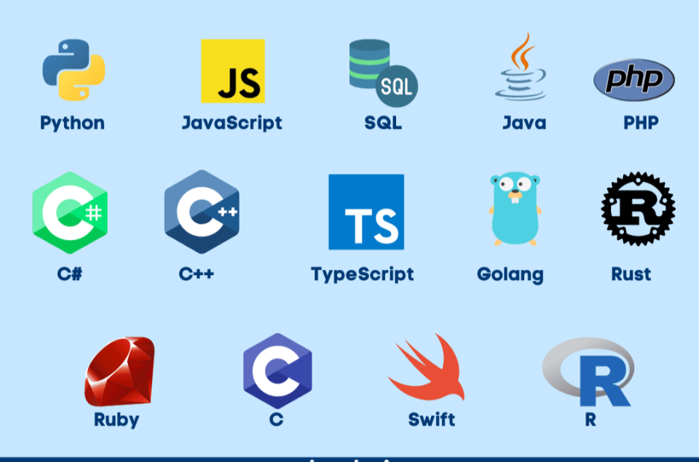
Why Programming Languages Exist?

Slide 5

IDE & Importance of Syntax

Slide 6
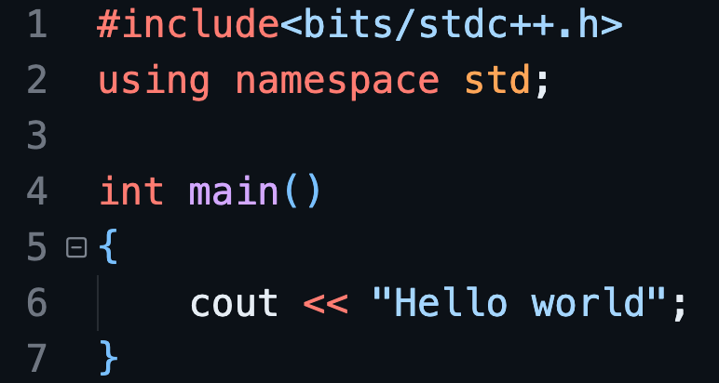
First C++ Code (Hello World)

Slide 7
SOME IMPORTANT RULES TO REMEMBER
  Semicolon: Every statement must end with ;
  Case Sensitive: cout will work, but COUt will not.
  Printing Text: Text must be inside double quotes.
  New Line: For a new line, use endl.
  Brackets Come in Pairs

Slide 8
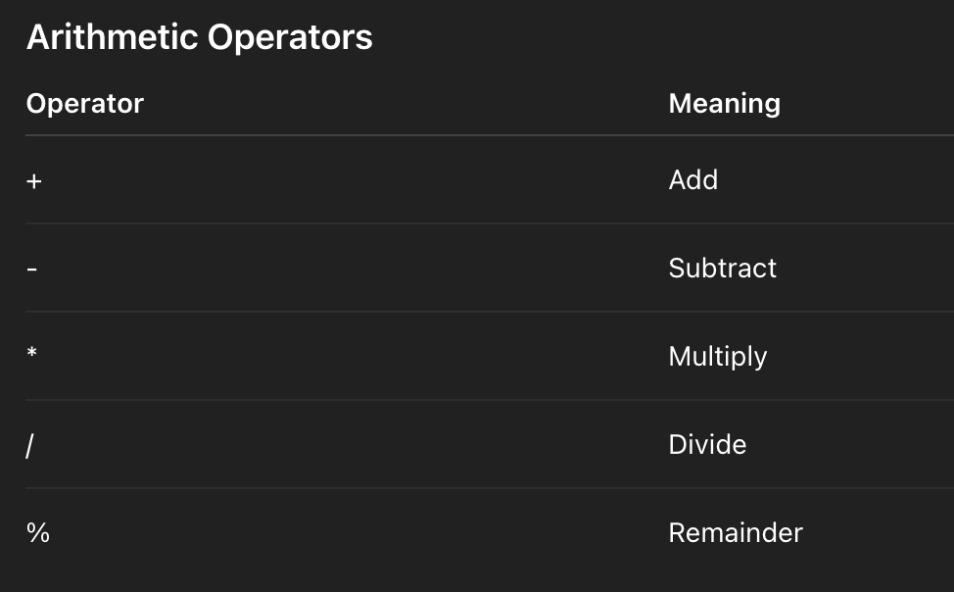
ARITHEMATIC Operators

Slide 9
VARIABLES
A variable is a named box in the computer’s memory where we store some data.

Slide 10
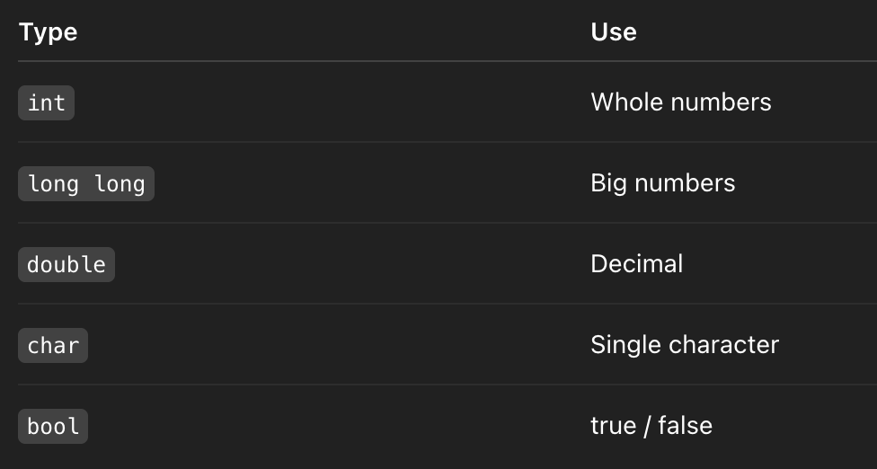
Data Types (FOUNDATION)

Slide 11
SOME IMPORTANT RULES TO REMEMBER
  Variable must be declared before use
  No spaces in variable names
  Case sensitive: marks ≠ Marks
  Name should be meaningful (not x1, a2 everywhere)

Slide 13
TAKING INPUT

Slide 14
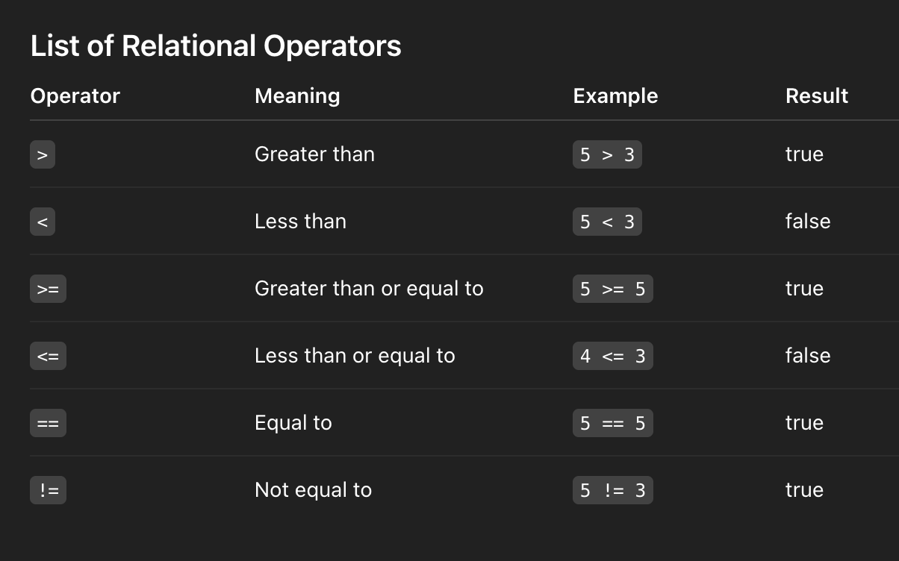
RELATIONAL OPERATORS

Slide 16
LOGICAL OPERATORS

Slide 17
CONDITIONALS

